Slide 1


Science project

Slide 2

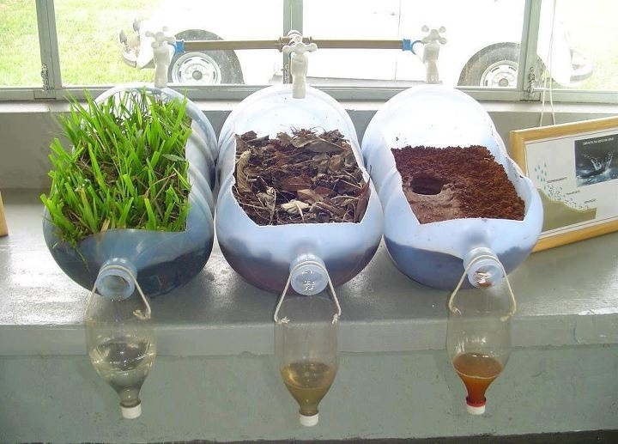
Introducing myself
“Hey there” my name is zara Khanum
I'm going to make a experiment and it is going to be fun.

Slide 3
THIRD!!!!
PUT WATER ON THE MOUND AND SLOWLY IT IS GOING TO WASH AWAY.
ITS YOUR GO!!!!!!
GOOD LUCK!!!!

Slide 4

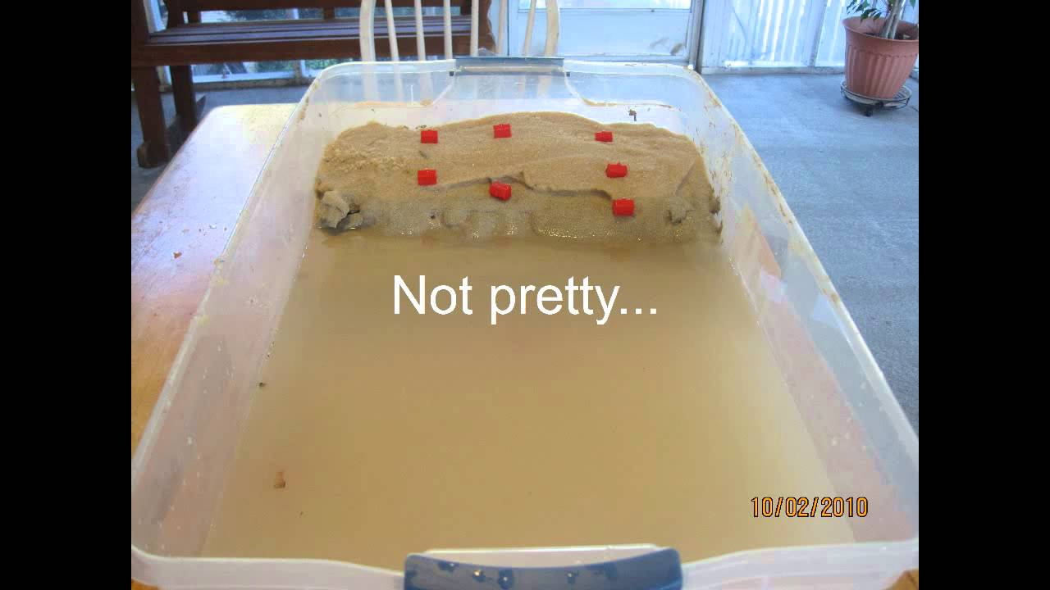
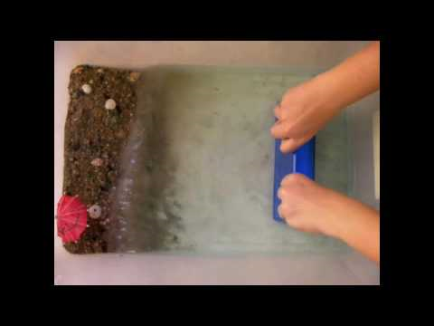
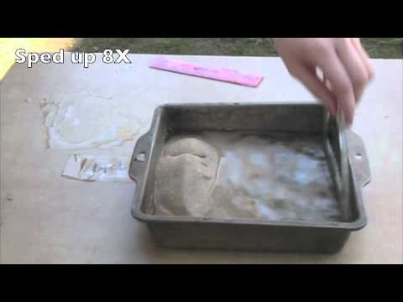
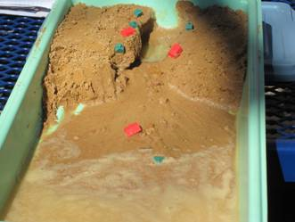
WHAT AM I MAKEING ????
I'm making erosion happan.
Like this

Slide 5



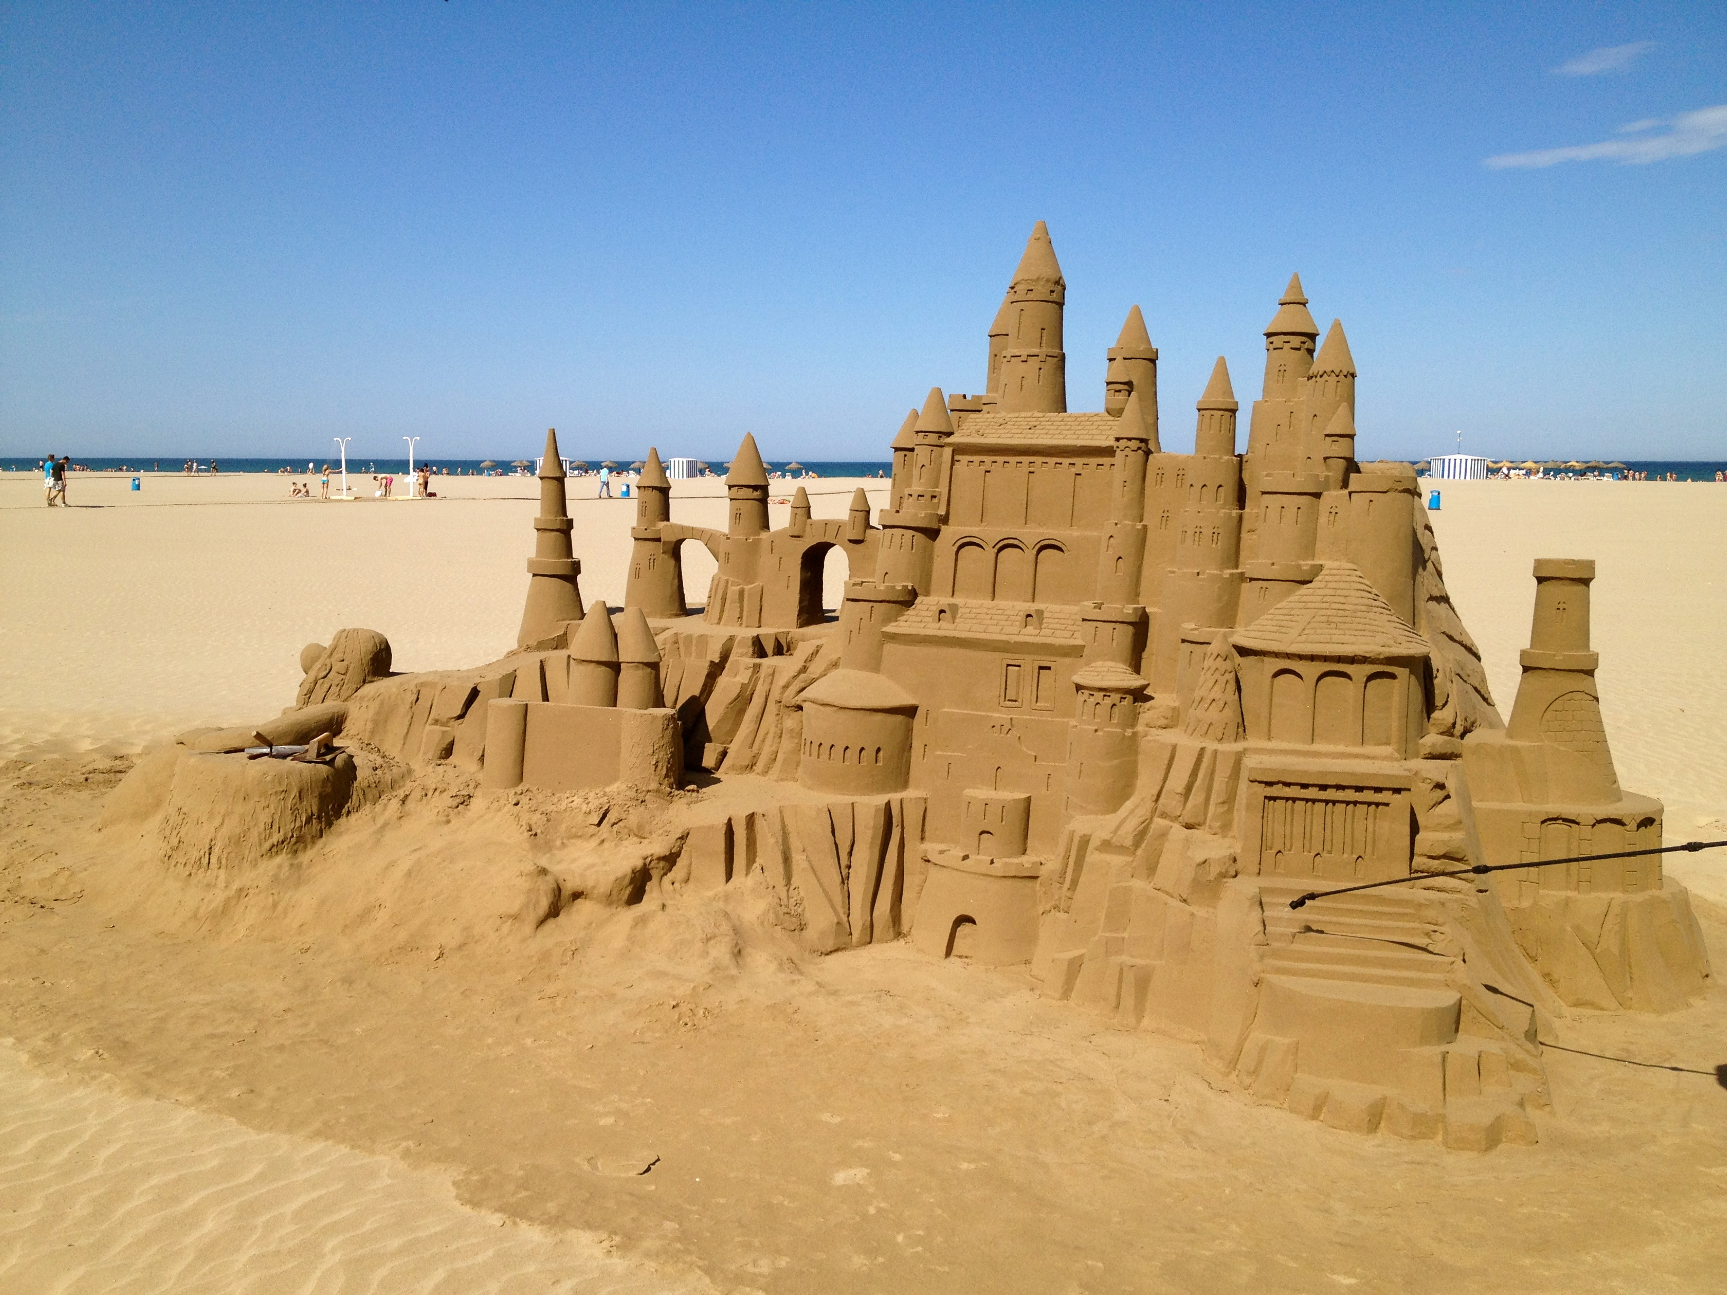
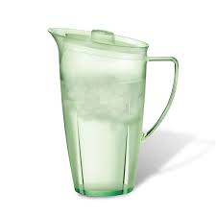
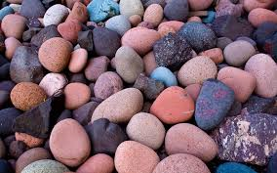
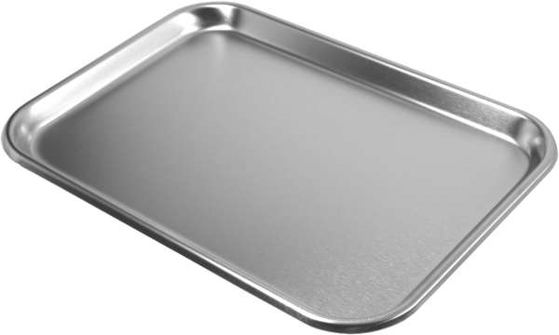
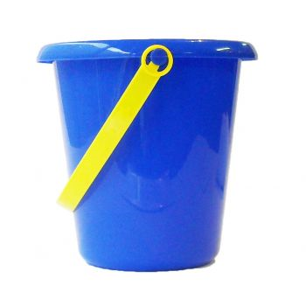
LET'S GET STARTED!!!!
FIRST WE NEED
SAND
1 JUG OF WATER
ROCKS
TRAY
BUCKET
SPOON

Slide 6
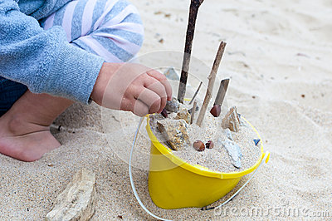
FIRST!!!!!!
GET THE BUCKET AND THE SAND PUT THE SAND INTO THE BUCKET THEN GET THE ROCKS AND PUT IT INTO THE BUCKETMIX REALLY WELL.

Slide 7
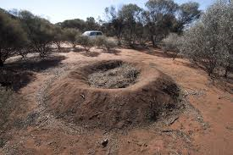
SECOND!!!!!!!
GET THE TRAY AND THE BUCKET AND POUR WHATS IN THE BUCKET SHAPE THE SAND AND ROCKS LIKE A MOUND

Slide 8
THIRD!!!!
PUT WATER ON THE MOUND AND SLOWLY IT IS GOING TO WASH AWAY.
ITS YOUR GO!!!!!!
GOOD LUCK!!!!

